Slide 1
JUnit Tutorial
Testing Framework for Java

Slide 2
JUNIT
It is an open-source testing framework for java programmers. The java programmer can create test cases and test his/her own code.
It is one of the unit testing framework. Current version is junit 4.
To perform unit testing, we need to create test cases. The unit test case is a code which ensures that the program logic works as expected.
The org.junit package contains many interfaces and classes for junit testing such as Assert, Test, Before, After etc.

Slide 3
Types of unit testing
1) Manual Testing
If you execute the test cases manually without any tool support, it is known as manual testing. It is time consuming and less reliable.
2) Automated Testing
If you execute the test cases by tool support, it is known as automated testing. It is fast and more reliable

Slide 4
Annotations for Junit testing
The Junit 4.x framework is annotation based, so let's see the annotations that can be used while writing the test cases.
@Test annotation specifies that method is the test method.
@Test(timeout=1000) annotation specifies that method will be failed if it takes longer than 1000 milliseconds (1 second).
@BeforeClass annotation specifies that method will be invoked only once, before starting all the tests.
@Before annotation specifies that method will be invoked before each test.
@After annotation specifies that method will be invoked after each test.
@AfterClass annotation specifies that method will be invoked only once, after finishing all the tests.
@Ignore or @Ignore("Why disabled"): Ignores the test method. This is useful when the underlying code has been changed and the test case has not yet been adapted.

Slide 5
Assert class
The org.junit.Assert class provides methods to assert the program logic.
Methods of Assert class
The common methods of Assert class are as follows:
void assertEquals(boolean expected,boolean actual): checks that two primitives/objects are equal. It is overloaded.
void assertTrue(boolean condition): checks that a condition is true.
void assertFalse(boolean condition): checks that a condition is false.
void assertNull(Object obj): checks that object is null.
void assertNotNull(Object obj): checks that object is not null.

Slide 6
Required jar files
We need to load
1. junit4.jar
2. org.hamcrest.core.jar

Slide 7
Using JUnit with Maven
To use JUnit in your Maven build, add the following dependency to your pom file.
<dependency>
<groupId>junit</groupId>
<artifactId>junit</artifactId>
<version>4.12</version>
</dependency>

Slide 8
Using JUnit integrated into Eclipse
The Eclipse IDE ships with a version of JUnit. If you use Eclipse, no additional download is required.

Slide 9
Simple JUnit example in eclipse IDE

Slide 10
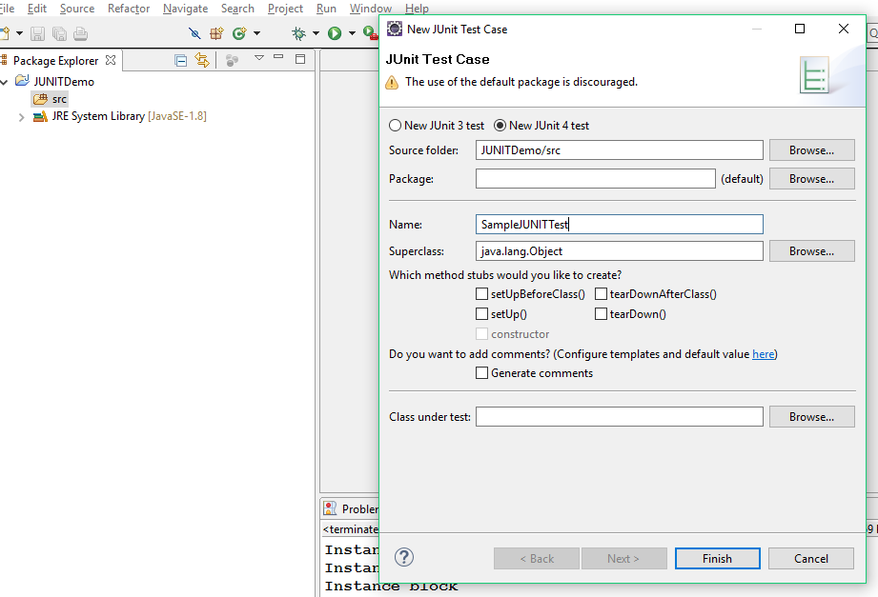
Create a new test case

Slide 11
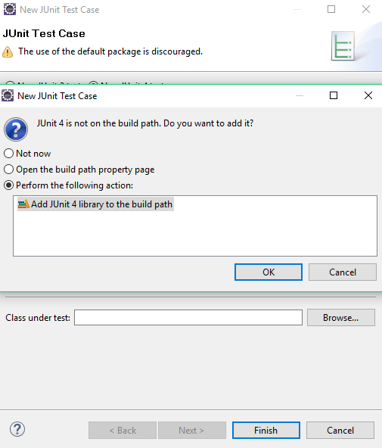
Junit jar file is automatically added from eclipse

Slide 12
SampleJUNITTest
public class SampleJUNITTest {
@Test
public void test() {
assertEquals("UnitTesting", "UnitTesting");
}
}

Slide 13
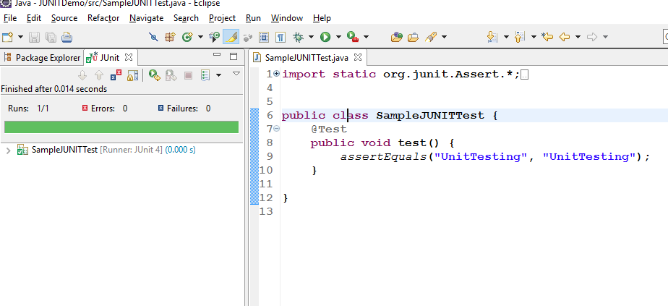
Right click on java file -> Run as Junit Test

Slide 14
Notes
TestCase java file will be created in separate folder As These files are not deployed in production environment.
Create Test case class with same class name with suffix Test
Ex:
Main class: Calculation
Test class: CalcuationTest
Create a method with same method name of the Main class with prefix test

Slide 15
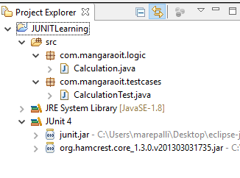
Directory Structure of This Example

Slide 16
Calculation.java
package com.mangaraoit.logic;
public class Calculation {
public int sum(int a, int b){
return a+b;
}
public int subtraction(int a, int b){
return a-b;
}
public int product(int a, int b){
return a*b;
}
public int division(int a, int b){
return a/b;
}}

Slide 17
Calculation Test
import com.mangaraoit.logic.Calculation;
public class CalculationTest {
@Test
public void testSum() {
Calculation c = new Calculation();
assertEquals(10, c.sum(10, 20));
assertEquals(-10, c.sum(10, 20));
}
}

Slide 18
Run this test case
right click on CalcuationTest class -> Run As -> Junit Test.

Slide 19
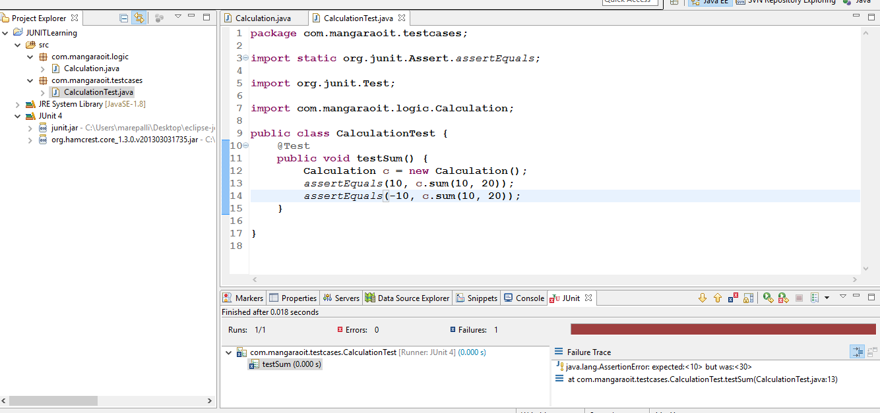
Output: Assertion Error

Slide 20
@ignore : It ignores the failure test case
public class CalculationTest {
@Test
public void testSum() {
Calculation c = new Calculation();
assertEquals(30, c.sum(10, 20));
}
@Ignore
public void testProduct() {
Calculation c = new Calculation();
assertEquals(100, c.product(10, 20));
}
}

Slide 21
@Before, @After
public class CalculationTest {
@Before
public void beforeClass() {
System.out.println("Before");
}
@After
public void after() {
System.out.println("AfterClass");
}
@Test
public void testSum() {
Calculation c = new Calculation();
System.out.println("testSum method");
assertEquals(30, c.sum(10, 20));
}
@Test
public void testProduct() {
System.out.println("testProduct method");
Calculation c = new Calculation();
assertEquals(200, c.product(10, 20));
}}

Slide 22
Output
Before
testSum method
After
Before
testProd method
After

Slide 23
Note
@BeforeClass, @AfterClass methods should be static otherwise Initialization will be occurred.

Slide 24
@BeforeClass @AfterClass
import com.mangaraoit.logic.Calculation;
public class CalculationTest {
static Calculation c = null;
@BeforeClass
public static void beforeClass() {
System.out.println("BeforeClass");
c = new Calculation();
}
@AfterClass
public static void afterClass() {
System.out.println("AfterClass");
c = null;
}
@Test
public void testSum() {
System.out.println("testSum method");
assertEquals(30, c.sum(10, 20));
}
@Test
public void testProduct() {
System.out.println("testProduct method");
assertEquals(200, c.product(10, 20));
}
}

Slide 25
output
BeforeClass
testSum method
testProduct method
AfterClass

Slide 26
assertTrue() and assertFalse() methods

Slide 27
Create Utility class
public class Utility {
public boolean isPalindrome(String name) {
return name.equals(new StringBuffer(name).reverse().toString());
}
}

Slide 28
UtilityTest
public class UtilityTest {
@Test
public void testIsPalindrome() {
Utility utility = new Utility();
assertTrue(utility.isPalindrome("MADAM"));
assertFalse(utility.isPalindrome("MADAM"));
}}

Slide 29
assertArrayEquals() method
public class UtilityTest {
@Test
public void testArraySort(){
int[] nums = {20,10,50,10,40};
Arrays.sort(nums);
int[] expectedOutput = {10,20,30,40,50};
assertArrayEquals(expectedOutput, nums);
} }

Slide 30
@Test(expected = NullPointerException.class)
@Test(expected = NullPointerException.class)
public void testArraySortWithNullCondition() {
int[] nums = null;
Arrays.sort(nums);
}

Slide 31
@Test(timeout=milliseconds)
@Test(timeout=1000)
public void testArraySortWithNullCondition() {
for (int i = 1; i < 1000000000; i++) {
int[] nums = {i,i-1,1-2};
Arrays.sort(nums);
}
}

Slide 32
Test suite
Test suite means bundle a few unit test cases and run it together. In JUnit, both @RunWith and @Suite annotation are used to run the suite test. Here is an example which uses TestJunit1 & TestJunit2 test classes.

Slide 33
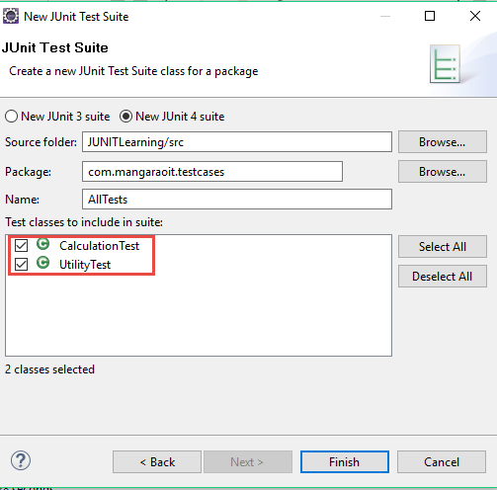
Create New TestSuite class

Slide 34
AllTests – TestSuite
import org.junit.runner.RunWith;
import org.junit.runners.Suite;
import org.junit.runners.Suite.SuiteClasses;
@RunWith(Suite.class)
@SuiteClasses({ CalculationTest.class, UtilityTest.class })
public class AllTests {
}

Slide 35
Run Test suite class
Right Click on Test suite class – Run as Junit Test
It runs all test cases that are mentioned in the test suite class.

